Slide 1

Lariat rental car fleet analysis
Prepared for Lariat Executives
Presented by Chaitra

Slide 2
Goals of this presentation
Review options for minimizing costs and maximizing revenue
Compare options to each other to assist in decision making process

Slide 3

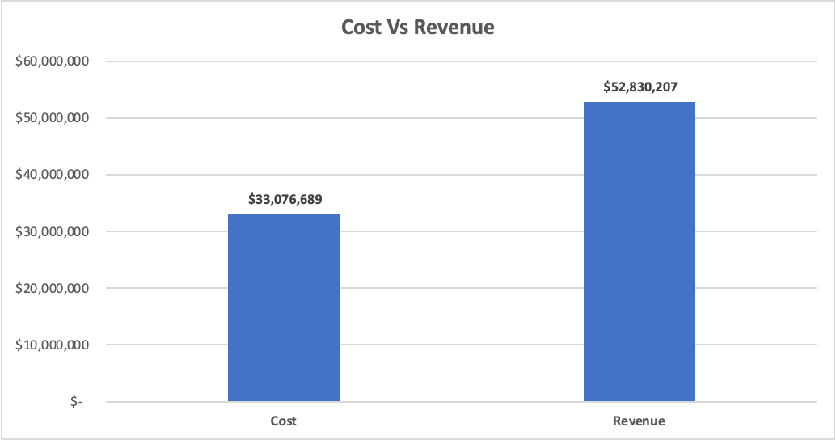
Baseline performance of Lariat rental vehicle fleet
Cost vs revenue for Lariat is positive with yearly net profit of 19 million dollars

Slide 4
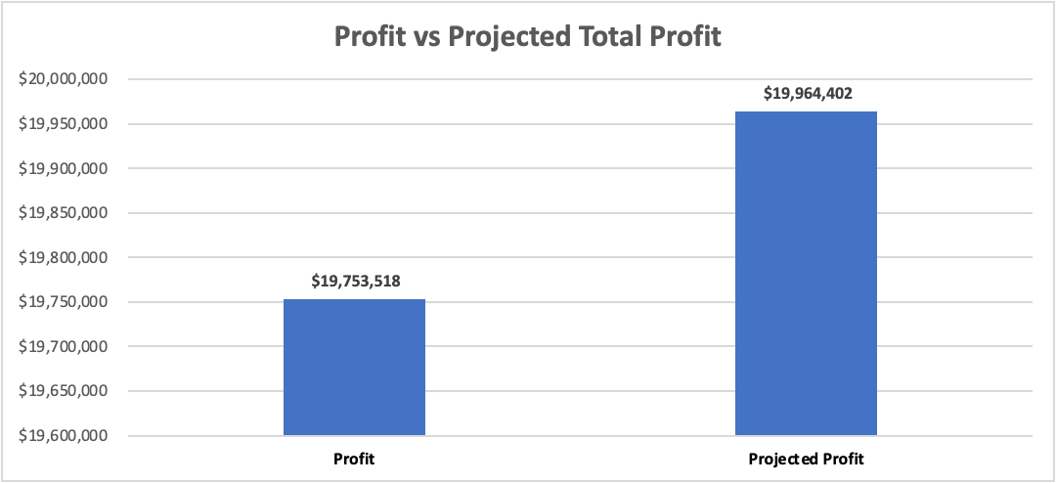
Model 1 : Removal of loss-making cars
Current metrics
total count of loss-making cars | 200
total no of cars | 4000
% of loss-making cars | 5%
Total Loss | $ (210,884)
Avg Loss per Car | $ (1,054)
Elimination of loss-making cars
Profit Impact | $ 210,884
Projected Profit | $ 19,964,402
By eliminating loss making cars the loss becomes "zero’ which increases you profit by 1%.

Slide 5
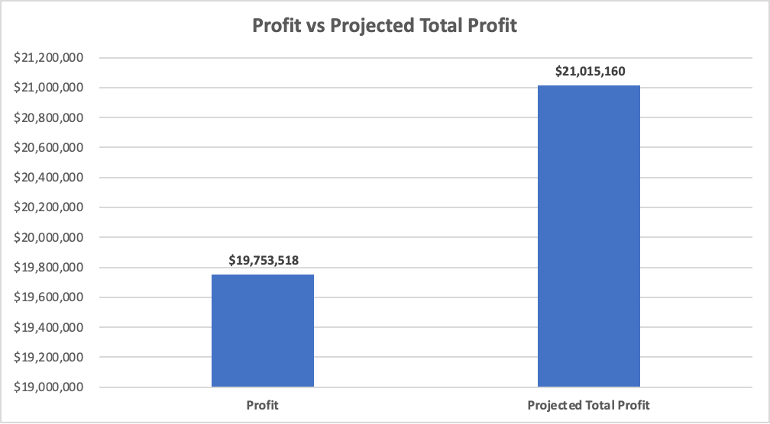
Model 2 :Converting loss-making cars to profit-making cars through marketing or cost reduction
Current metrics
total count of loss-making cars | 200
total no of cars | 4000
% of loss-making cars | 5%
Total Loss | $ (210,884)
Avg Loss per Car | $ (1,054)
Elimination of loss-making cars
Profit Impact | $ 1,261,642
Projected Profit | $ 21,051,60
Converting loss-making cars to profit-making cars you profit increase is 6%

Slide 6
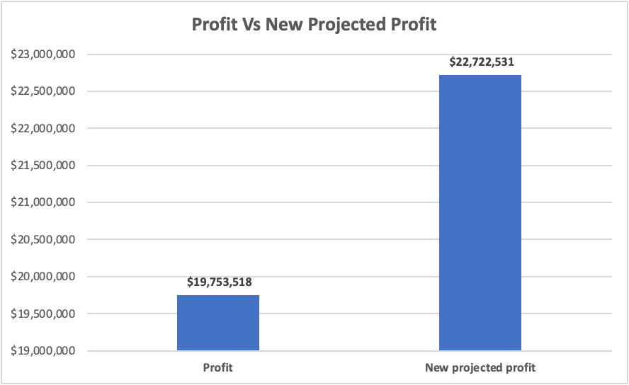
Model 3 :Replace loss-making cars with top 10 most profitable cars
Current metrics
total count of loss-making cars | 200
total no of cars | 4000
% of loss-making cars | 5%
Total Loss | $ (210,884)
Avg Loss per Car | $ (1,054)
Replace loss-making cars with top 10 profitable cars
Profit Impact | $ 2,969,013
New projected profit | $ 22,722,531
Replacing all the 200 loss-making cars with the top 10 most profit-making cars, the profit impact is almost 2.5M which is 15% increase in profit

Slide 7
Review options for increasing profit
Eliminate loss-making cars completely
Convert the loss-making cars to profitable cars through marketing or by reducing their maintenance cost or insurance (using a different vendor for insurance or maintenance)
Replacing all the loss-making cars with the top 10 most profit-making cars

Slide 8
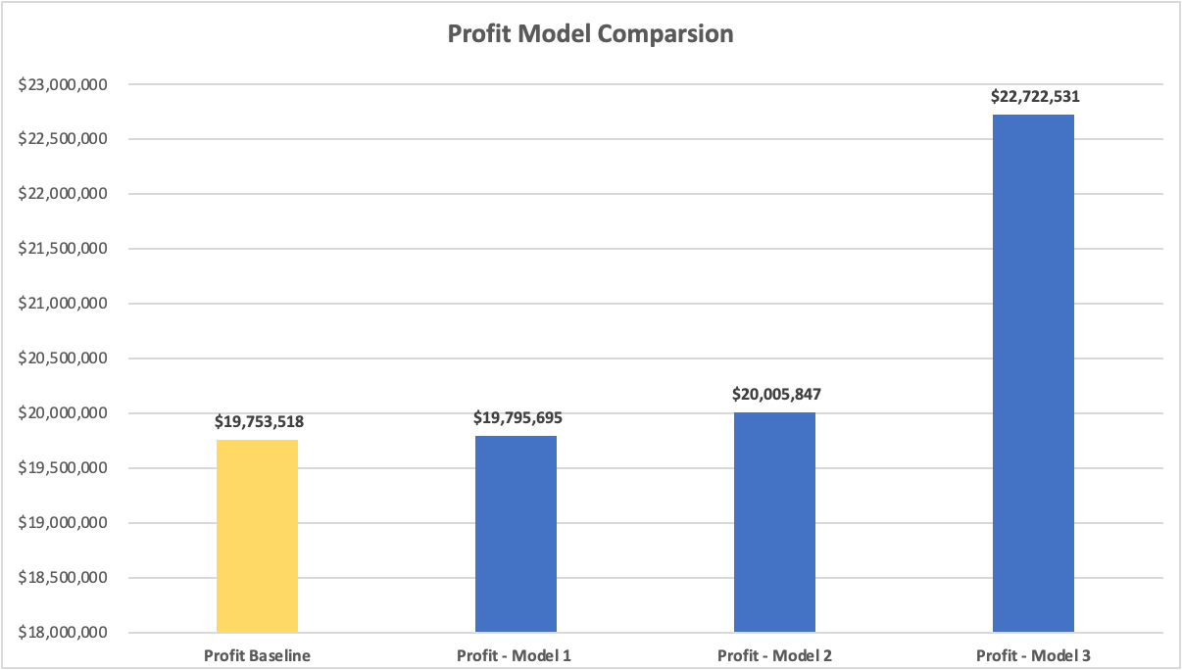
How options compare
Model 3 produces a profit of almost 2.5M which is 15% increase in the total profit

Slide 9
Lariat goal is maximizing profit
Recommend replacing all loss-making cars with top 10 most profit-making cars. profit impact is greater with this model compared to other models
If no action is taken, client may continue with the current losses
Call to action

Slide 10

Thank you

